Slide 1
The International Baccalaureate Program
Winston Churchill High School

Slide 2
IB is
a program that encourages students to ask challenging questions, to critically reflect, to develop research skills, and to learn how to learn.
The aim of all IB programs is to develop internationally minded people who, recognizing their common humanity and shared guardianship of the plant, help to create a better and more peaceful world.

Slide 3
IB Learner Profile
Inquirers Knowledgeable
Thinkers Communicators
Principled Caring
Open-minded Risk-takers
Balanced Reflective

Slide 4
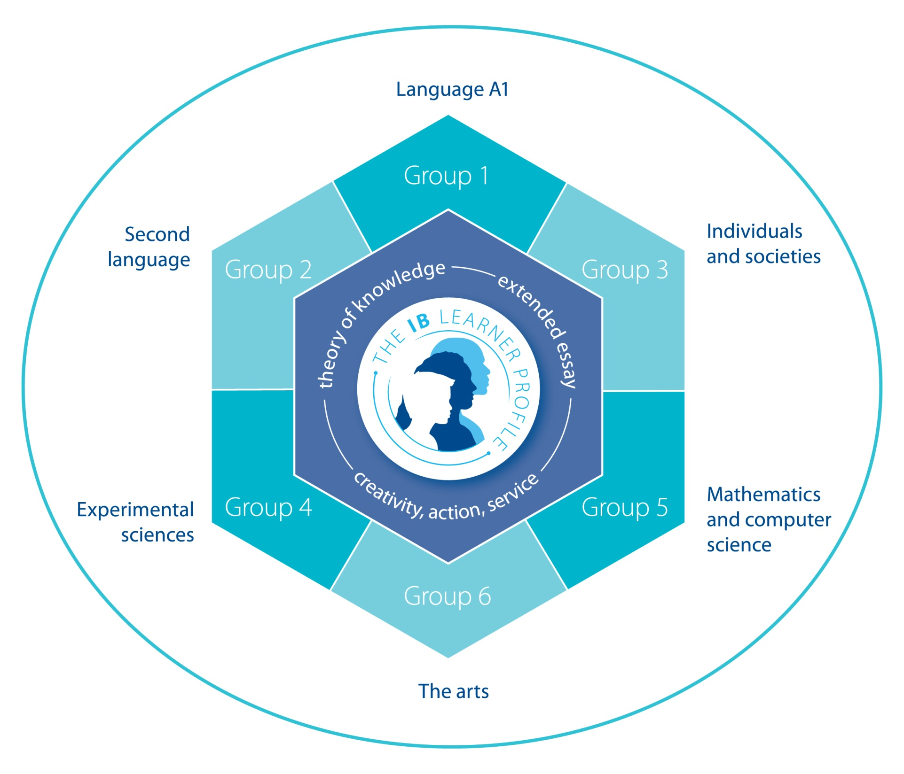

Slide 5
The Program: course work in six subjects.
Group 1 – Language A1 (English)
Group 2 – Second Language (French, Spanish)
Group 3 – Individuals & Society (International Politics)
Group 4 – Experimental Science (Biology)
Group 5 – Mathematics
Group 6 – Option/The Arts (Chemistry, Art, Music)
**You can still be involved in all programs Churchill has to offer even though course selection may be limited.

Slide 6
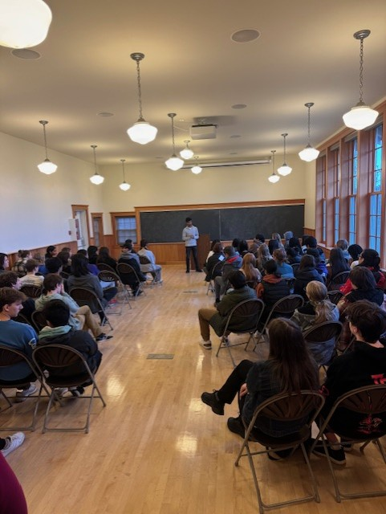
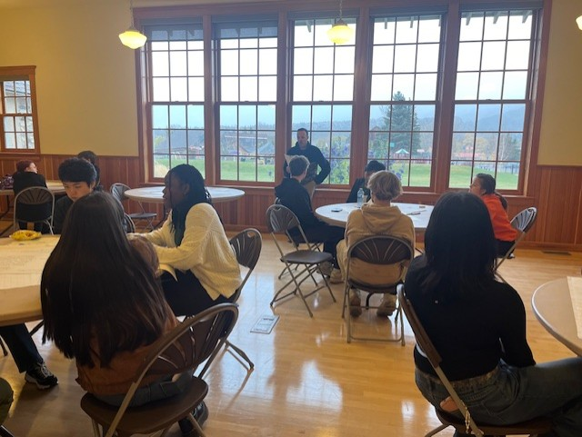
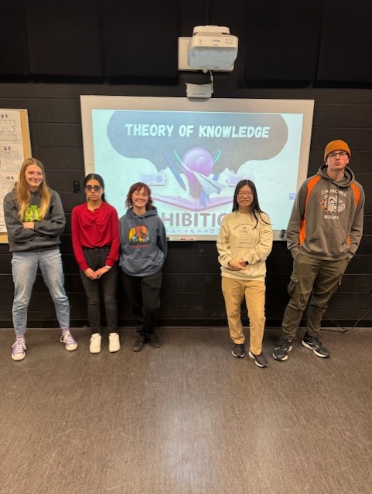
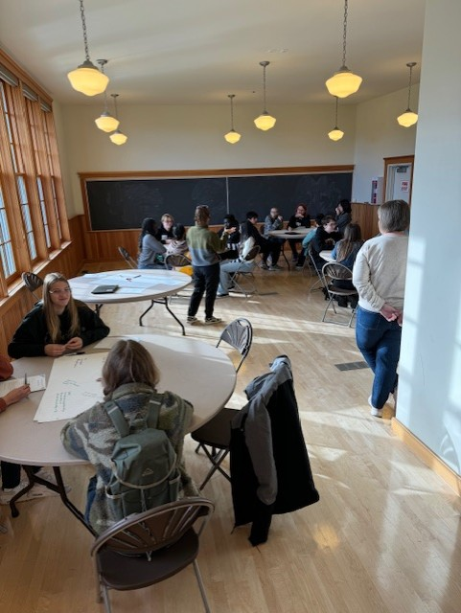
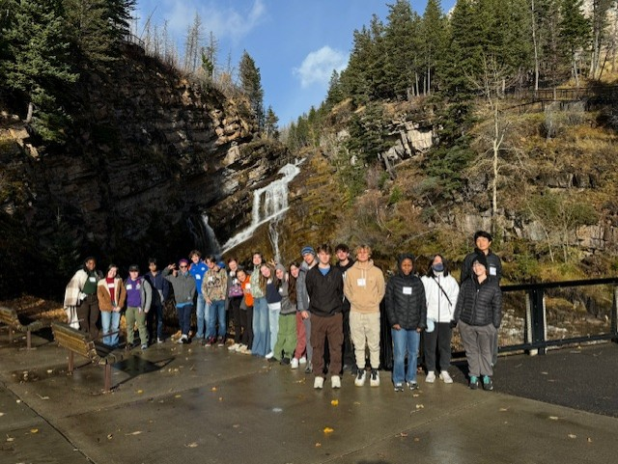
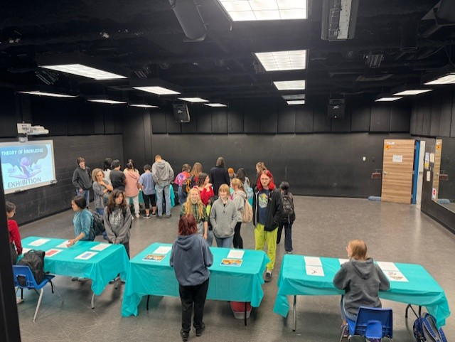

Slide 7
Additional Requirements:
Theory of Knowledge (ToK)
A 100 hour program over two years focusing on Ways of Knowing, Problems of Knowledge and Areas of Knowledge.
A 1200-1400 word essay on one of ten prescribed titles.
Extended Essay
A substantial piece of independent research of about 4000 words in a subject chosen by the student.
Creativity, Action & Service (CAS)
150 h over two years devoted to CAS

Slide 8
Full Diploma Schedule
Grade 10 |  | Grade 11 |  | Grade 12
Semester 1 | Semester 2 | Semester 1 | Semester 2 | Semester 1 | Semester 2
English 10i | Spanish or French 10i | English 20i | Social 20i | English 30i | World Lit 25i/ International Politics 25i
Science 10i | Social 10i | Biology 20i | Spanish or French 20i | Social 30i | Biology 25i/ Chemistry 25i
Math 10i | Math 20i | Math 30i | Math 31i | Biology 30i | French 30 or Spanish 30i
Option | PE – CALM | Chemistry 20i or Art 20i or Music 20i | Physics 20 or Option | Chemistry 30i or Art 30i or Music 30i | Option or Physics 30
TOK is embedded into the full IB schedule. It starts in May of grade 11. Students do not have register for this course.

Slide 9
So why International Baccalaureate?
IB students learn a variety of skills
IB students get to challenge themselves
Learn with like-minded individuals
Learn important skills such as time-management and organization
IB students engage in curriculum with students all over the world.
IB retreat

Slide 10
So why International Baccalaureate?
IB Challenges
Is a rigorous academic program for university bound students
Will be challenging and stimulating for academically motivated students
Is a ‘global’ program in which students around the world share a common curriculum and examinations
IB Benefits
Receive excellent preparation for university
Improve reading and writing skills
Have teachers that have received professional development necessary for teaching IB

Slide 11
Additional Information
If you want to take IB, you must start in grade 10.
You will get a city transit pass for transportation.
Nowhere is the learner profile does it say IB is about grades.
IB presentation for families on April 17th @ 7:00pm.
Grade 9 does have a IB prep course for grade 9 students to take as an option.

Slide 12
QUESTIONS???
*What’s next if you want to apply for the IB program at Churchill?
If you have any questions about the IB program, please feel free to reach out to me anytime.
aaron.becking@lethsd.ab.ca

